Slide 1

Tourism App
Muhammad Ali Ilyas
(19-Arid-037)
Muhammad Ali Ilyas
(19-Arid-037)
(Date: 04/03/2021)
Supervisor: Ms. Fakhar Un Nisa
Department of Computer Science
Barani Institute of Management Sciences, Rawalpindi

Slide 2
Introduction
In this era, the internet is one of the main sources of news which include different social media platforms and websites. Nowadays people are very busy with different regular works that’s why they are relying on online news because these platforms are considered a fast and easy source of information.
Social media such as Facebook and Twitter are at the peak position of usage these days. People use them for various reasons, for example, entertainment, democracy, learning, health tips, online shopping, weather forecast, to see top trending news, and much more [1].
The existing research proposed techniques that are mostly based on Natural Language Processing. ‘Human-like Language Processing’ reveals that NLP is considered a discipline within Artificial Intelligence [8].
In this research, the detection of the fake news is performed through a proposed model that is based on ensemble classifiers which are the combinations of different machine learning and deep learning models.
Notes:
1- main usage social media
2- twitter facebook
3- usage of twiiter entertainment
4- share karty hain news without authentication of current affairs
5- schemers is ka faida uthaty hain yeah 1 thread ha
6- isko overcome karnay kay liay bohat say reserachers nay different techniques use ki hain isay overcome karny ky liay

Slide 3
Existing Systems
Existing System | Limitations | Technology
Text | Text | Text

Slide 4
Problem Statement
Fake news are big challenges of all types of media, especially social media. The extensive spread of fake news has the potential for extremely negative impacts on individuals and society. It is very difficult to discriminate between real and fake news. To overcome this problem, several approaches have been proposed that include NLP-based technique [13], CNN and RNN based deep learning technique [32], and robust technique using the voting classifier [31]. However, the proposed approaches are not effective for reducing data dimensionality. In addition, when not using the feature extraction and feature selection mechanism simultaneously skips important features available in data. Consequently, the real meaning of data is changed that resulting in computational overheads [33]. Moreover, these techniques also do not perform well on data that contains high noise and high inconsistency [34]. Therefore, this research aims to propose a framework for the efficient detection of fake news on social media platforms based on ensemble methods.
[13] F. I. Adiba, T. Islam, M. S. Kaiser, M. Mahmud, en M. A. Rahman, “Effect of corpora on classification of fake news using naive Bayes classifier”, International Journal of Automation,2020.
[31] A. Mahabub, “A robust technique of fake news detection using Ensemble Voting Classifier and comparison with other classifiers”, SN Appl. Sci., vol 2, no 4, Apr 2020.
[32] O. Ajao, D. Bhowmik, en S. Zargari, “Fake news identification on twitter with hybrid CNN and RNN models”, in Proceedings of the 9th International Conference on Social Media and Society, Copenhagen Denmark, pp.226-230, 2018.
[33] F. S. Samani, H. Zhang, en R. Stadler, “Efficient learning on high-dimensional operational data”, in 2019 15th International Conference on Network and Service Management (CNSM), Halifax, NS, Canada, p.1-9, 2019.
[34] K. Shu, A. Sliva, S. Wang, J. Tang, en H. Liu, “Fake news detection on social media: A data mining perspective”, arXiv [cs.SI], pp.22-36, 2017.

Slide 5
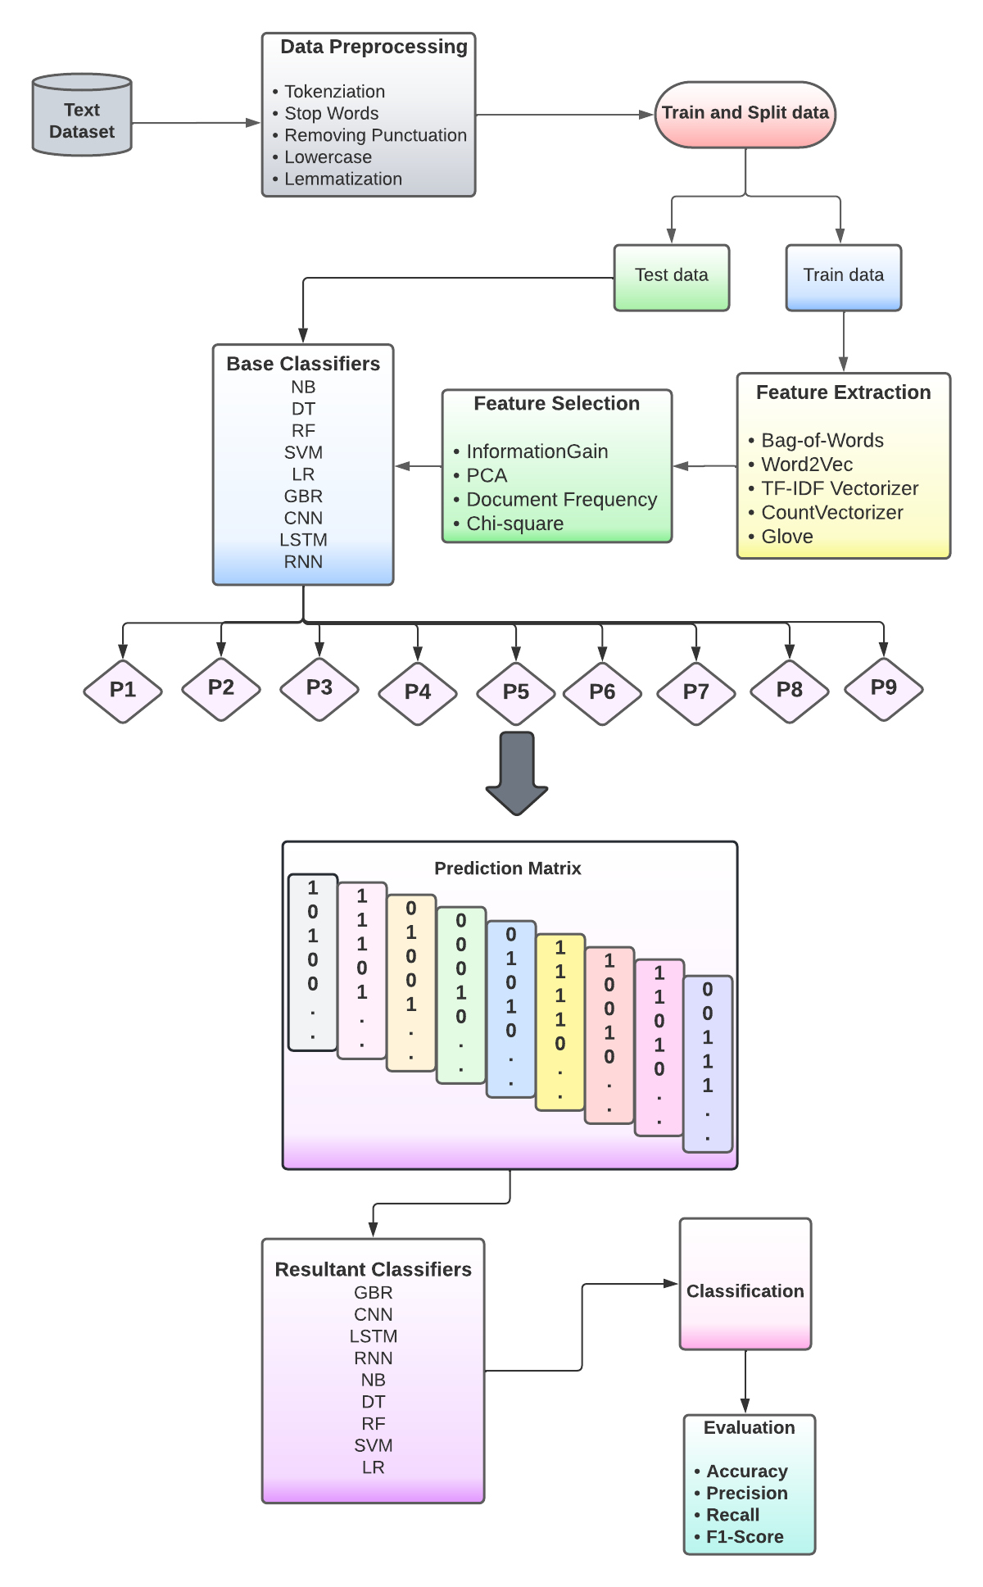
Proposed Solution (System Model)
The fake news detection is performed through multiple proposed ensemble classifiers which are the combination of machine learning and deep learning models.
A model is proposed which incorporates both feature extraction and selection techniques to reduce high dimensionality.
The proposed model is evaluated using three different types of datasets. Moreover, the comparison of the model is performed with the state-of-the-art studies.

Slide 6
Tools and Technology
Add tools languages and system specifications which would be used in development

Slide 7
Significance
Different combination of the classifiers are ensembled which includes Naive Bayes and Decision Tree, Random Forest and Naive Bayes, Random Forest and Support Vector Machine, Decision Tree and Random Forest, and Decision Tree with Random Forest. These ensemble classifiers achieved 95%, 96%, 93%, 98%, and, 91% accuracy, respectively.
These experiments shows that Decision Tree and Random Forest outperforms as compared to other combinations with 98% accuracy.
.

Slide 8
References
[1] H. Ledford, “How Facebook, Twitter and other data troves are revolutionizing social science”, Nature, vol 582, no 7812, pp.328–330, Jun 2020.
[8] K. Chowdhary, “Natural language processing. Fundamentals of artificial intelligence”, pp.603–649, 2020
[6] S. Hakak, M. Alazab, S. Khan, T. R. Gadekallu, P. K. R. Maddikunta, en W. Z. Khan, “An ensemble machine learning approach through effective feature extraction to classify fake news”, Future Gener. Comput. Syst., vol 117, pp. 47–58, Apr 2021.
[11] M. Granik en V. Mesyura, “Fake news detection using naive Bayes classifier”, in 2017 IEEE First Ukraine Conference on Electrical and Computer Engineering (UKRCON), Kiev,2017.
[12] A. Thota, P. Tilak, S. Ahluwalia, en N. Lohia, “Fake news detection: a deep learning approach”, SMU Data Science Review, vol 1, no 3, 2018.
[15] T. Chen, X. Li, H. Yin, en J. Zhang, “Call attention to rumors: Deep attention based recurrent neural networks for early rumor detection”, in Lecture Notes in Computer Science, Cham: Springer International Publishing, pp. 40–52, 2018.
[13] F. I. Adiba, T. Islam, M. S. Kaiser, M. Mahmud, en M. A. Rahman, “Effect of corpora on classification of fake news using naive Bayes classifier”, International Journal of Automation,2020.
[31] A. Mahabub, “A robust technique of fake news detection using Ensemble Voting Classifier and comparison with other classifiers”, SN Appl. Sci., vol 2, no 4, Apr 2020.
[32] O. Ajao, D. Bhowmik, en S. Zargari, “Fake news identification on twitter with hybrid CNN and RNN models”, in Proceedings of the 9th International Conference on Social Media and Society, Copenhagen Denmark, pp.226-230, 2018.
[33] F. S. Samani, H. Zhang, en R. Stadler, “Efficient learning on high-dimensional operational data”, in 2019 15th International Conference on Network and Service Management (CNSM), Halifax, NS, Canada, p.1-9, 2019.
[34] K. Shu, A. Sliva, S. Wang, J. Tang, en H. Liu, “Fake news detection on social media: A data mining perspective”, arXiv [cs.SI], pp.22-36, 2017.
[35] https://www.kaggle.com/datasets [Online], Accessed Date: 1-January-2022.

